Slide 1

Onboarding Technical Kick Off
Interweave Portal

Slide 2
Introduction
The purpose of this session is to walk through the technical considerations relevant to using the Interweave Portal.
The portal is a web-based application, and letting users view it should normally involve minimal technical work.
However there are still a few things to consider - for example regarding user management, logon mechanisms, and support.
2

Slide 3
Portal Overview
Although not strictly part of this “technical” presentation, there are a couple of obvious questions which you may be asking first:
See demo video at: https://www.interweavedigital.com/shared-care-record-portal/
What does it look like?
See data provision grid at: https://www.interweavedigital.com/customer-support/data-provision/
What data is available?

Slide 4
Technical Considerations
Modern Browser – Chrome and Edge are supported – it will not function in old non –supported browsers such as Internet Explorer, and it will also not function if Edge is run in 'IE mode' which is sometimes the practice required to support legacy applications.
It is not fully tested on Firefox and Safari
Internet access to the Portal website – normal internet access for browsing a website, ensuring that any Content Filtering does not block it
Managed device – a securely managed device to mitigate potential risks of malicious key-logging, screen-capture etc
Mobile Phone - for two-factor authentication, if not context launching. This is currently via SMS. Any UK mobile number can be used.
Bookmarks / shortcuts (optional) – to make it easier for users to find and remember the website

Slide 5
Options - Logon
There are a few options available to customise how the Portal works for your organisation.
Once these are confirmed your “tenancy” will be created with these settings
A completely standalone web application, viewed in the browser.
Authentication – self-contained with 2-factor authentication.
A ready-to-use solution for care settings where there is minimal existing IT. (Or a tactical quick-win until more sophisticated integration can be achieved).
Standalone
Still a separate web application but can be 'popped up' from within an existing system.
Integration to provide single sign-on and patient context passing.
Provides an impression of integration whilst still taking advantage of a pre-built Interweave Portal web app. Useful for care settings where there is a single dominant application, with limited ability to modify.
Launch in patient context
Several widely-used systems are already pre-integrated for context launching the Portal (check for latest list)
Alternatively a standard specification (based on JWT Tokens) is available.
For further details see: https://www.interweavedigital.com/customer-support/technical/

Slide 6
Options – GP Connect
GP Connect is the National Service to allow viewing of the GP Record
It is one of the most valuable features of the Portal, and most implementations want to use it
  However… you may already have access to the GP Record by another means. For example, if you are yourself a GP!
You will need an authorisation code (ASID) from NHSD to allow your organisation to access GP Connect.
  This should be a formality, as the Interweave Portal has already passed the necessary NHSD Governance. However the requirement needs to be flagged so that this can be requested in good time.

Slide 7
Options – Other
We strongly encourage “keeping it simple” and using the standard, vanilla, Interweave Portal.
However other configurations are possible, and are mentioned here for completeness.
Additional Panels – the Interweave Portal continues to be developed with new panels (screens) regularly added. However if you have a specific need for other panels to satisfy your use-case then this should be raised as early as possible so development can be planned
Granular roles – in theory you could configure granular roles, so that different Portal users are allowed to use different screens. However in practice all implementations so far have opted for a simpler “all users can see everything” approach
Customised menus – in a similar vein, it is in theory possible to customise the menus and to select a particular subset of screens and/or adjust the way they are organised. However in practice there are significant advantages in remaining with the standard, supported configuration
Advanced integration – the Interweave Portal is a modular system (see Appendix), and it may be possible to take individual components and integrate more deeply with a different website. However in practice the context launching approach is simpler, and has worked well for all implementations so far

Slide 8
User and Service Management
Confirm how users will be managed
User and Service Management
Register users in compliance with an identity management policy which provides a high degree of confidence that a person accessing the Portal can be identified and is authorised to do so.
Who will have access to the Portal – and how do they apply / get approved?
Starters and Leavers
Service Desk – to manage users, deal with incidents and liaise with interweave Service Management.
Estimate approximate number of users and usage patterns.
NB: Interweave provides the portal, however you will need to manage your users.
If the number of users is large, consider a phased rollout
Notes:
Resources:
Data Release DP
Governance for Data Consumers

Slide 9
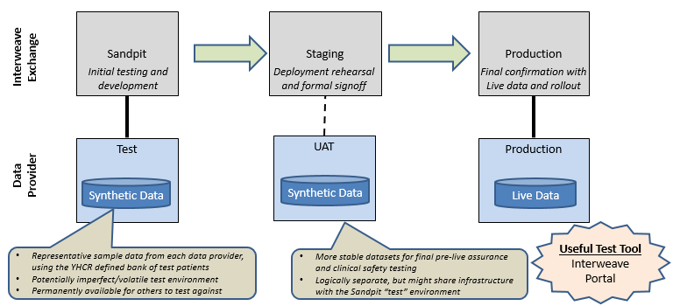
Test Environments
Planning testing
The portal itself has already been tested, but you will need to acceptance test the plans for using it within your own organisation.

Slide 10
Next Steps
How to get started
Get a test logon to the Interweave Portal – to experiment for yourself with the screens (panels) and example data.
Plan your configuration – confirm use of GP Connect, authentication approach, plus any other configuration options.
Plan user management and support – confirm how users will be registered, monitored, and issues handled.
Plan acceptance testing – to ensure that the portal works as anticipated in your organisation, and is useful, usable, and safe.
Notes:
Resources:
Yhcr.org
- YHCR Design Paper 14/15 - Governance for Data Providers/Consumers
TA checklist

Slide 11



Appendix - Canvas and Panels Architecture
Canvas
Core functionality
eg authentication, authorisation, FHIR connectivity, layout, branding, personalisation, context management
Library
An 'app store' for panels
Enabling an ecosystem of independent panel developers
Develop in language of choice
Panels are modular and can be 'plugged in' without source-code dependencies
Panels
Discrete UI components
eg demographics, timeline, appointments, medications, allergies, results etc
Notes:
Canvas and Panels documentation

